Slide 1

Brain inspired computing
using a FPAA Board
4th week catch-up session
Writing the FPAA/Digilent guide and implementing the lowpass filter using Digilent
Matthieu Divet
Jonathan Gomis
Annie Luo
Anonto Zaman
Special problem
ECE 8903
Dr. Alexandre Locquet
Dr. Damien Rontani

Slide 2
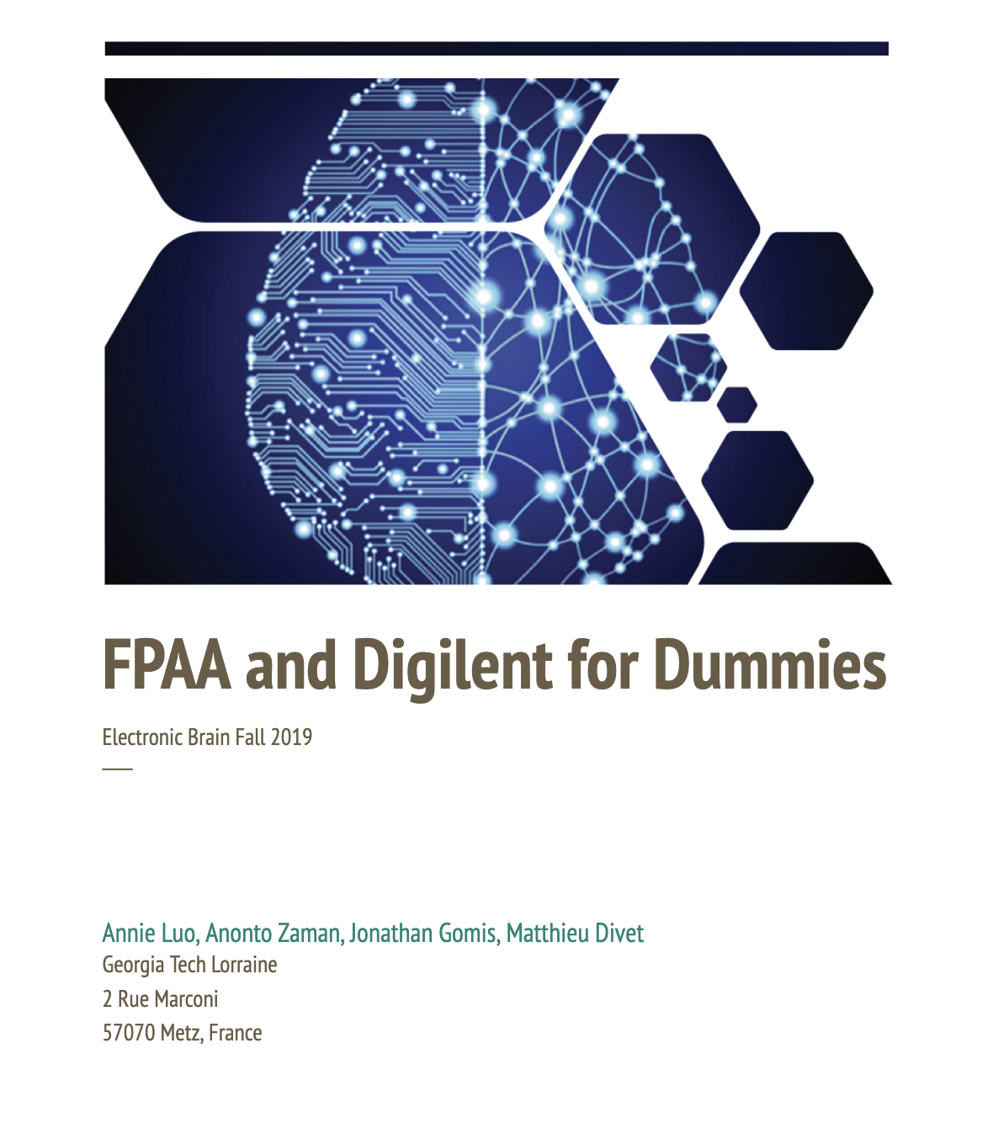
Creating a Guide on How to Interface the FPAA and the Digilent Analog Discovery 2
Anonto and I began to write the guide
Put all the useful tutorial links and software download links
Started writing a step-by-step guide on how to calibrate the device and how to connect it to the FPAA
https://docs.google.com/document/d/13_y1GTvY7PMY0dI0dSKVj2wEq0nv9Nxw8GiICx8u2FU/edit?usp=sharing

Slide 3
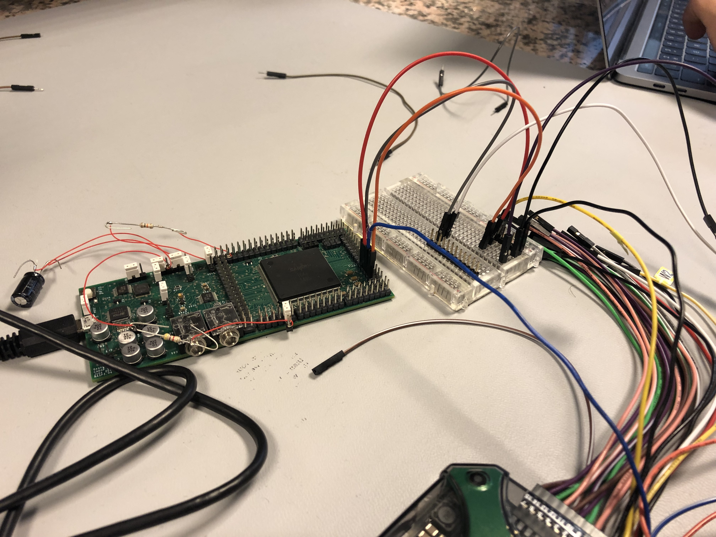
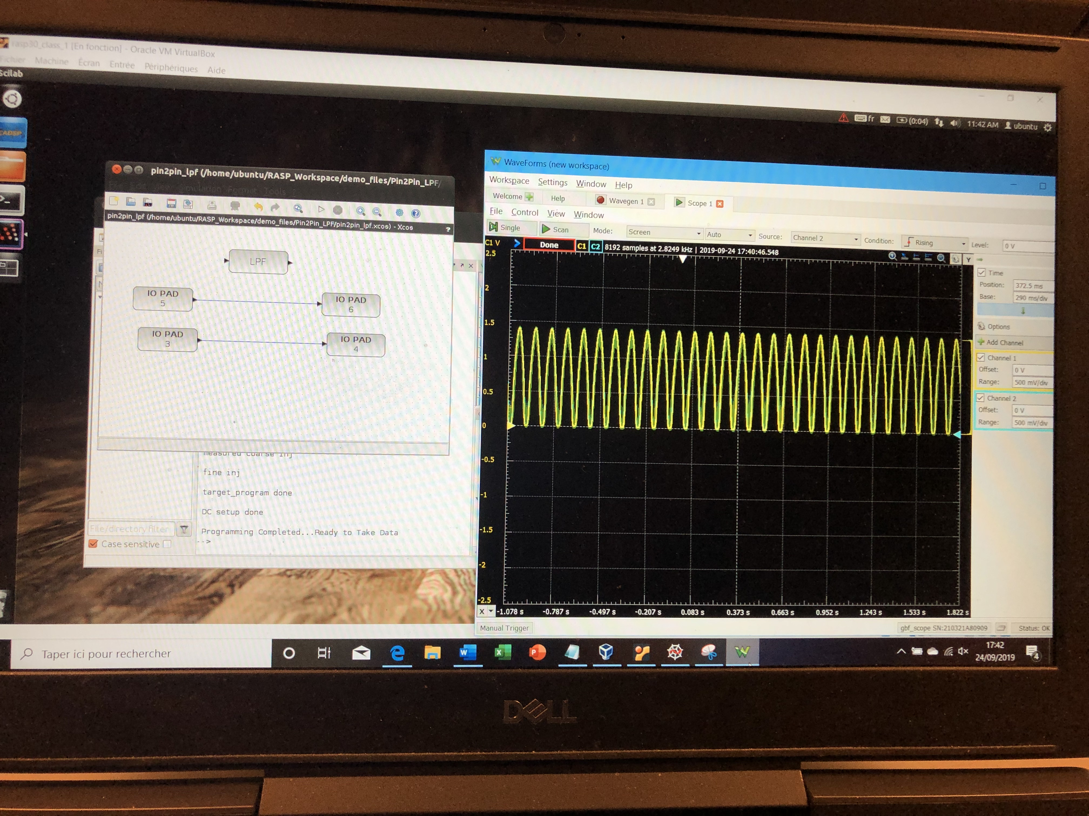
Testing an off-chip LPF design using the FPAA and Digilent
Managed to pass a signal from one pin and out another
Could not implement the LPF, more testing to come
Tried both high and low frequencies
Ended up removing the LPF from the design before implementation to check that different pins were working
Noticed that the pins were very sensitive, bumping one could change the waveform entirely

